Slide 1
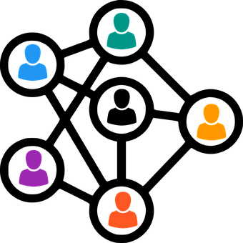
Create and configure p2p network
Presented by-
Group No 12

Slide 2
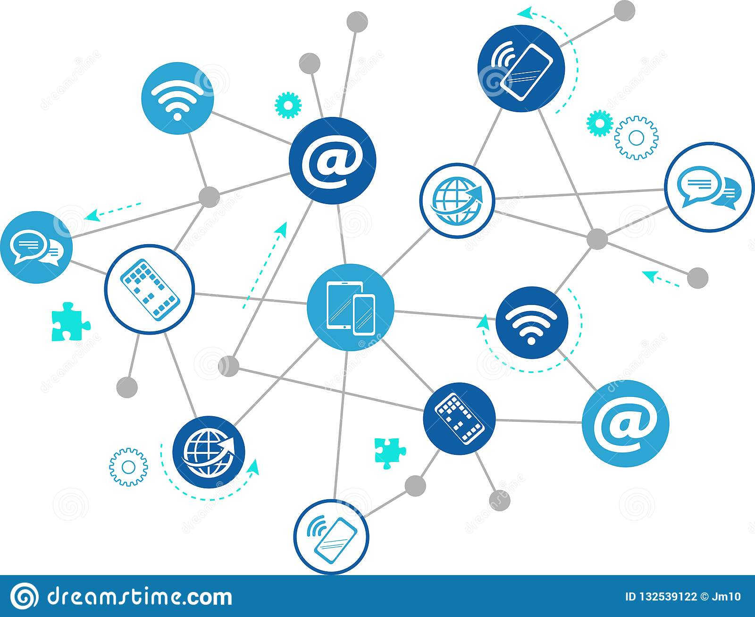

Introduction
Data is a collection of facts, such as numbers, words, measurements, observations or just descriptions of things.
Communication is simply the act of transferring information from one place, person or group to another.

Slide 3

Data Communication
Data communication refers to the exchange of data between a source and a receiver via form of transmission media such as a wire cable.
The physical connection between networked computing devices is established using either cable media or wireless media.

Slide 4
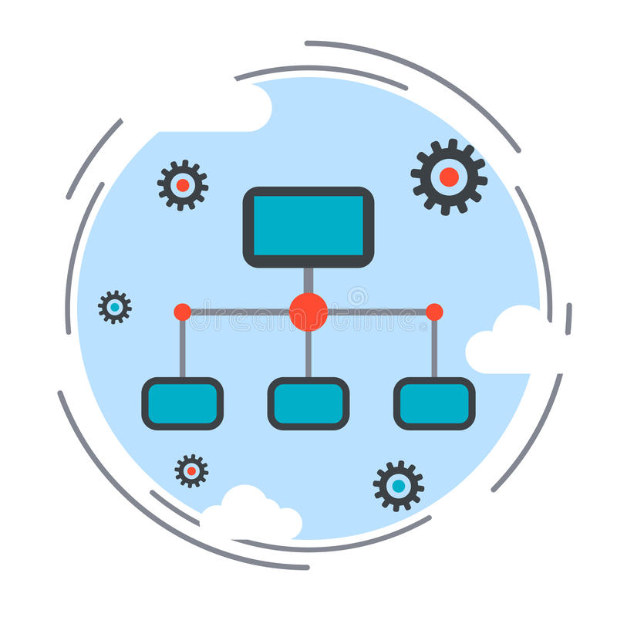
Computer Network
A computer network is a group of computers linked to each other that enables the computer to communicate with another computer and share their resources, data, and applications.

Slide 5
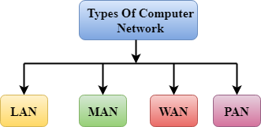

Slide 6
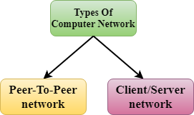

Slide 7
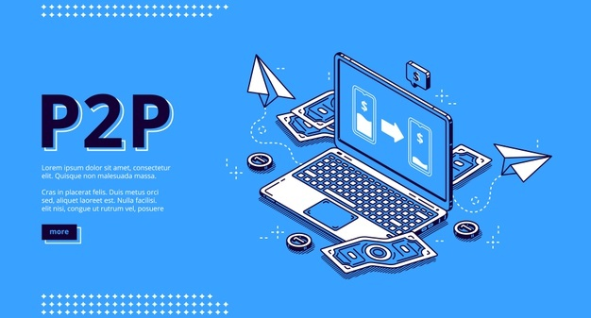
Peer to Peer Network (P2P)
A peer-to-peer network is a technology that allows you to connect two or more computers to one system.
This connection allows you to easily share data without having to use a separate server for your file-sharing.

Slide 8
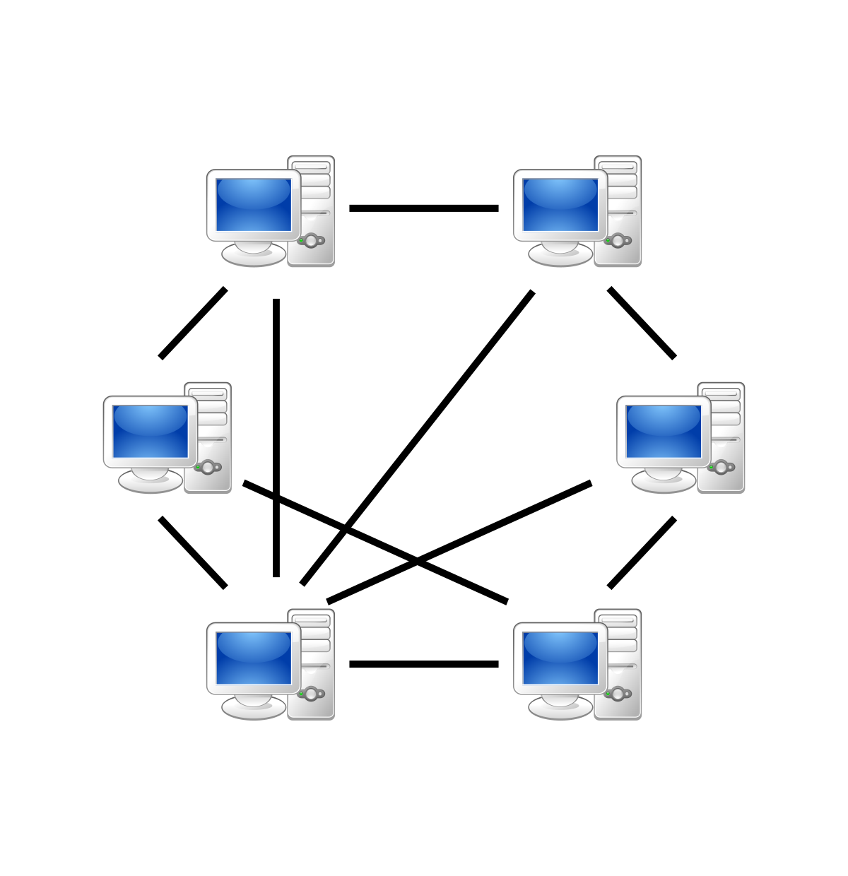
P2P Network Architecture

Slide 9
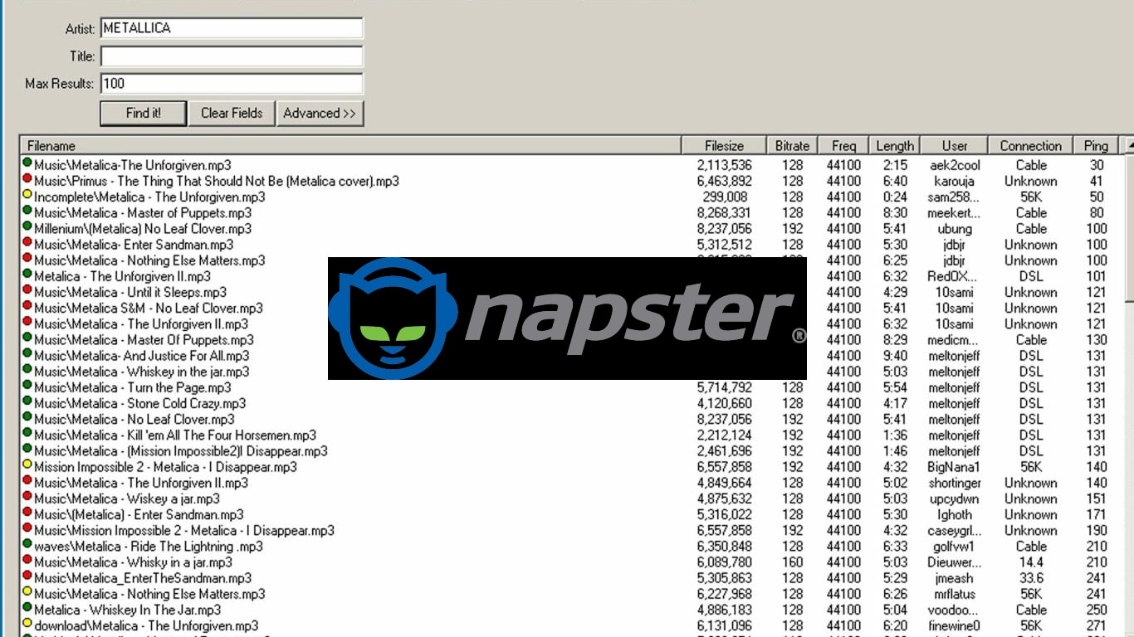
History
P2P file sharing was introduced to the general public in 1999 when American college student Shawn Fanning created the music-sharing service Napster.

Slide 10

Shawn Fanning

Slide 11
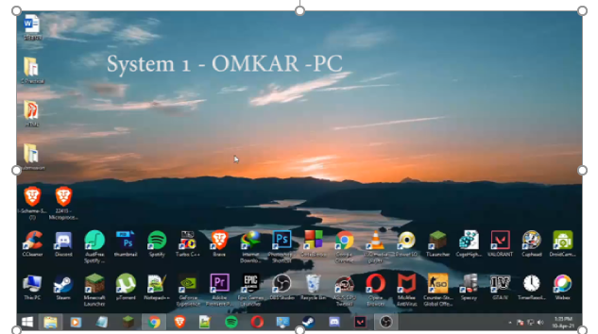
Demonstration Video

Slide 12

Advantages
Cost
Implementation
Administration
Resource Sharing

Slide 13

Disadvantages
Performance
Security
Backup Recovery
Virus Attack

Slide 14
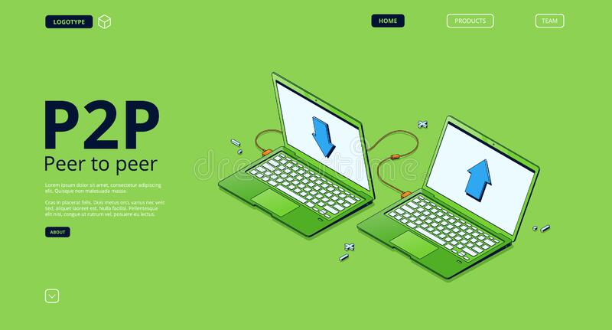
Conclusion
In peer-to-peer (P2P) networking, a group of computers are linked together with equal permissions and responsibilities for processing data.
Unlike traditional client-server networking, no devices in a P2P network are designated solely to serve or to receive data.
It was invented by Shawn Fanning in 1999.

Slide 15


